Slide 1
Connected Device Studio IoT Hub Receiver
Walker Lin
Microsoft IoT Innovation Center

Slide 2
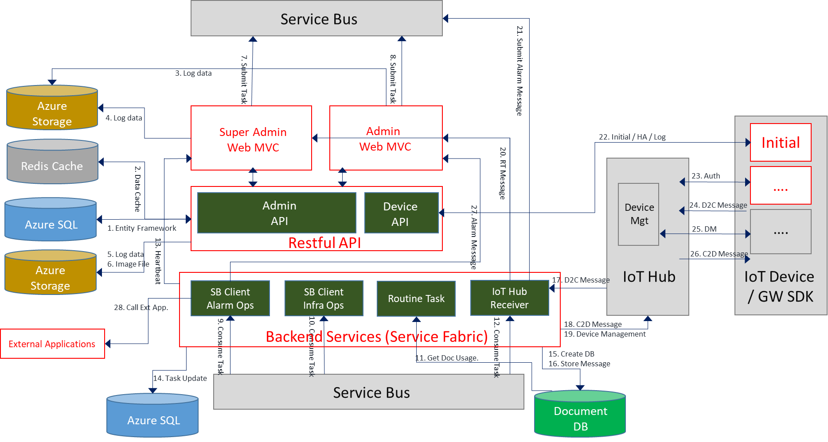
Architecture

Slide 3
IoT Hub Receiver
Goal
Handle the real-time data processing from IoT Hub to validate the messages, watch the alarms with a rule engine, store the historic data and feed the telemetry data to back-end service for remote monitoring.
Features
Processing telemetry data from IoT Hub by EventProcessorHost library
Message validation
Alarm Rule Engine
Fire the alarm message to the back-end service
Store the historic data and alarm messages in Cosmos DB
Feed the telemetry data to the back-end service for real-time dashboard
Heartbeat supported
Failover on IoT Hub
Lifecycle management (Start/Restart/Stop/Shutdown)

Slide 4
Diagram
BLOB
SQL DB
OpsAlarm
Cosmos DB
Azure
Service Bus
IoT Hub Receiver
Admin Web
IoT Hub Alias
Alarm Triggered
1
2
3
4
5
IoT Hub (Primary)
Telemetry data Ingestion
Message
Validation
Alarm
Rule
Engine
Historic
Data
and Alarm
Feed-in Message
IoT Hub (Secondary)
6
Service Bus
Heartbeat
7
Lifecycle Management
OpsInfra

Slide 5
1. Telemetry Data Ingestion
Using EventProcessorHost Library to read the data from IoT Hub
Failover on IoT Hub

Slide 6
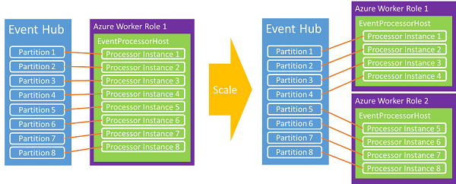
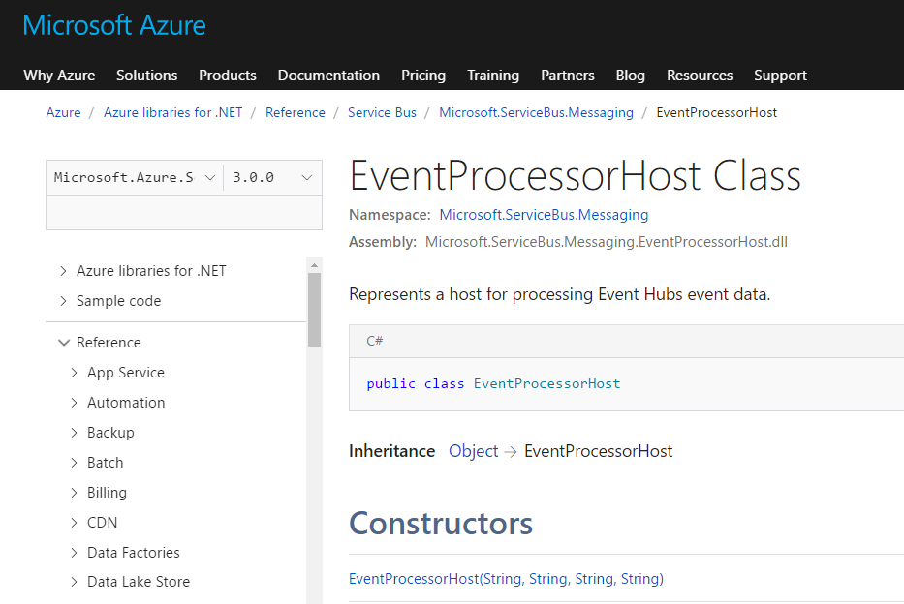
Event Processor Host
The EventProcessorHost class processes data from Event Hubs/IoT Hubs.
Building event readers on the .NET platform
Provides a thread-safe, multi-process, safe runtime environment
Also provides checkpointing and partition lease management
Event Hubs programming guide
https://docs.microsoft.com/en-us/azure/event-hubs/event-hubs-programming-guide
Event​Processor​Host Class
https://docs.microsoft.com/en-us/dotnet/api/microsoft.servicebus.messaging.eventprocessorhost?view=azureservicebuseps-3.0.0

Slide 7
Flow
Start
OpenAsync
Stop
InitialOffsetProvider
Partition Id
Start Time
Fetch Available IoT Hub
Register
EventProcessor
ProcessAsync
CloseAsync
Check the available IoT Hub
IoT Hub Alias
Get the info. From SQL DB
Endpoint of IoT Hub
Connection String of IoT Hub
Consumer Group of IoT Hub
Connection String of Storage Account for Blob
Message Validation
Alarm Rule Engine
Store Historic Data and Alarm
Feed-in Messages
Checkpoint
Partition Id
Stop Time
Exceptions
Unregister
EventProcessor
IoT Hub Failover
Send out a RESTART command to Topic of Service Bus
Re-started by Lifecycle Management

Slide 8
2. Message Validation
Hierarchy
Load the Message Catalog ID list by each IoT device in this IoT Hub
Validate the coming message by Device ID and Message Catalog ID
Pass this message to the next module, or drop it if it is invalidate.
IoT Hub
Message Catalog ID 1
IoT Device ID 1
Message Catalog ID 2
IoT Device ID 2
Message Catalog ID 3
IoT Device ID 3
Message Catalog ID 4
…
…

Slide 9
3. Alarm Rule Engine
Use the 3rd open source library - Yet Another Rules Engine for .Net
https://www.nuget.org/packages/YetAnotherRulesEngine/
Real-time message processing in the Rule Engine
Time Window with a interval setting
Send a Alarm Message to OpsAlarm when the engine was detected an Alarm.
Store the Alarm Message as historic alarm

Slide 10
Flow
Run Alarm Rules
By Message Catalog ID
Put to Historic Alarm
RunSingleRuleItem
Left-op-Right
Ex. A >= 10
Store in Cosmos DB
Start
Multiple Rule Items?
Yes
Within the time window
Load Alarm Rules
Time Window interval?
No
Load all rules by devices in memory.
CompileBitWiseRules
AND, OR, and XOR
Ex. A >= 10 AND B = “Error”
Yes,
Skip sending this alarm.
No
Alarm Triggered?
When the Message Comes in
Yes
Send Alarm Message
No
Done
OpsAlarm

Slide 11
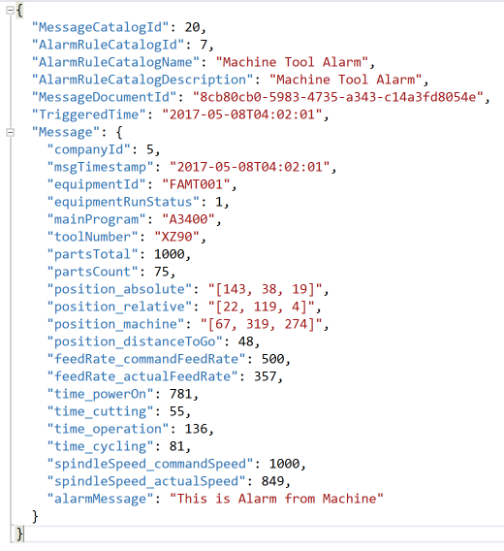
Send Alarm Message
Template Sample
sfBackendService/ServiceBusMessage/Queue-OpsAlarm-MessageCreate.json

Slide 12
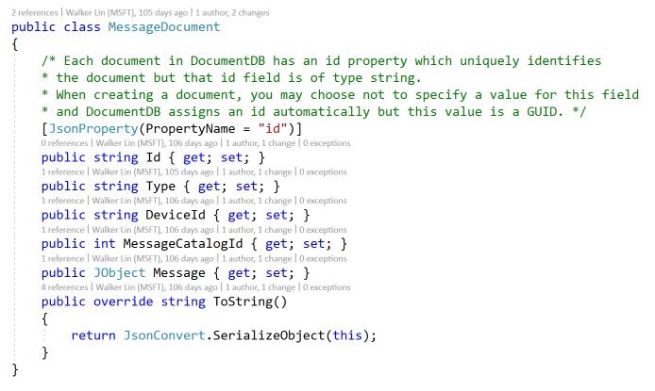
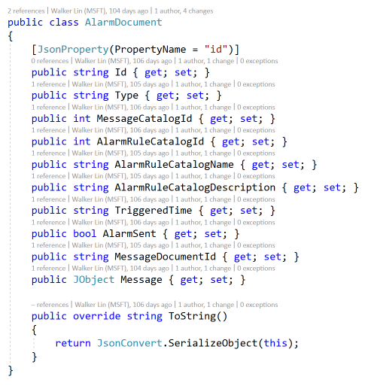
4. Historic Data and Alarm
Message Type
Alarm Type

Slide 13
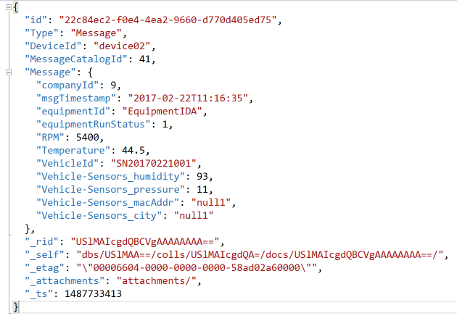
Message Document
Template Sample
sfBackendService/DocumentDB/MessageDocument.json
Properties
Id: The ID of this document
Type: It’s a Message
DeviceId: The ID of this device
MessageCatalogId: The ID of this Message Catalog
Message: The payload of this message
The others are the properties of Cosmos DB

Slide 14
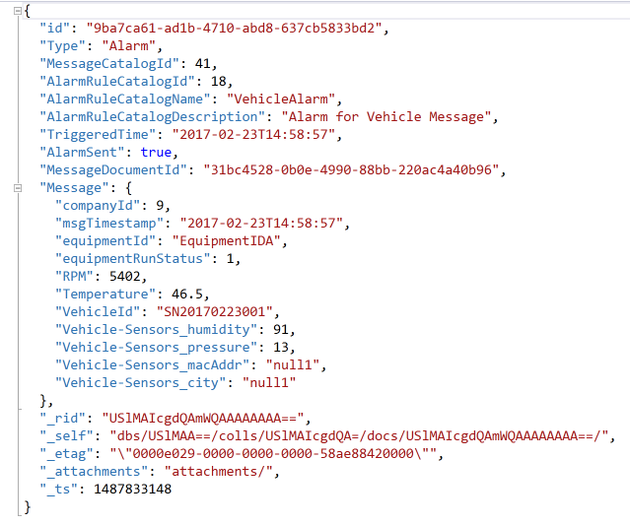
Alarm Document
Template Sample
sfBackendService/DocumentDB/AlarmDocument.json
Properties
Id: The ID of this document
Type: It’s a Alarm
AlarmRuleCatalogId: The ID of this alarm rule catalog which was triggered.
TriggeredTime: The time the alarm was triggered.
AlarmSent: Indicates whether the alarm has sent to Service Bus
MessageDocumentId: Indicates the document ID of message that is related to this alarm.
Message: The payload of this message

Slide 15
5. Feed-in Message
HTTP POST
URL: The URL of API service
Defined in App.config
<add key="RTMessageFeedInURL"value="http://<website>/Monitor/RTMessageFeedIn" />
Content: Telemetry Payload + Message Catalog ID

Slide 16
6. Heartbeat
Heartbeat Message
Company ID
Topic Name of Service Bus
IoT Hub Alias
IoT Hub Node (Primary/ Secondary)
Status (Running/ Stop)
Time Stamp (UTC time)
HTTP POST (The default interval is 10 seconds)
Admin URL: The URL of API service
Defined in App.config
<add key=“sfAdminHeartbeatURL"value="http://<admin>/Monitor/RTMessageFeedIn" />
Super Admin URL: The URL of API service
Defined in App.config
<add key=“sfSuperAdminHeartbeatURL"value="http://<super admin>/Monitor/RTMessageFeedIn" />
Content: Heartbeat Message

Slide 17
7. Lifecycle Management
4 States
Start/Restart/Stop/Shutdown
Admin/Super Admin
Launch/Delete via Service Fabric API
Restart by Topic of Service Bus
OpsInfra
Launch/
Delete
Restart
Report the Task Status
Success/Fail
API
Receiver
Sender
Sender
Service Fabric
Service Bus (Queue)
Service Bus (Topic)
Lifecycle Management
Receiver
Shutdown
Start
Stop
Restart

Slide 18
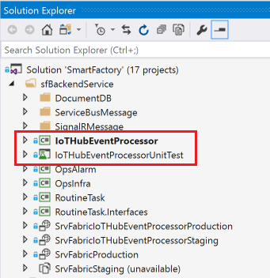
Project Structure
Folder: sfBackendService
2 Projects
IoTHubEventProcessor
IoT Hub Receiver
IoTHubEventProcessorUnitTest
The unit test for IoT Hub Receiver

Slide 19
What the next we can do
Read the telemetry data by per partition of IoT Hub
Resume the data ingestion by the last stopped time

